Slide 1
Machine Learning Approach for Predicting the Smoking Behavior Among Adolescents
Guide:
Mrs.X.Anitha Safarin
Associate Professor
Dept of CSE
MNMJEC
Team Members:
Akshath D Patni
Dhumavat Shubham
T Ganpath

Slide 2
OBJECTIVE
Consequently, there are two contributions in our project:
To Find the best-fitting model to predict smoking intention from the NYTS data.
(ii) Create a Form to help students , especially e-cigarette smokers, be able to prevent e-cigarette use due to possible chance of smoking cigarette

Slide 3
ABSTRACT
The use of electronic cigarette (e-cigarette) is increasing among adolescents. This is problematic since consuming nicotine at an early age can cause harmful effects in developing teenager’s brain and health
we proposes prediction models that can be used to predict an individual cigarette user’s intention to smoke cigarettes, so that one can be early informed about the risk of going down the path of smoking cigarettes
To construct the prediction models, ﬁve machine learning (ML) algorithms are exploited and tested for their accuracy in predicting the intention to smoke cigarettes among never smokers using data from the 2018 National Youth Tobacco Survey (NYTS)

Slide 4
INTRODUCTION
Smoking is a major preventable cause of death in both developed and developing countries. The global smoking rate was estimated to be 23.7% in 2010.
Tobacco dependence is a major cause of premature death, estimated at 6 million deaths per year. Maximum implementation of smoking cessation interventions can achieve greater lifesaving and economic benefits than most medical interventions for smoking-related diseases.
To reduce the growing global burden of tobacco-related mortality and morbidity, and the impact of tobacco use on economic indicators, tobacco control has become a global public health imperative.

Slide 5
LITERATURE SURVEY
Title | Author | Existing System | Proposed System
A machine-learning approach for predicting success in smoking cessation intervention | Khishigsuren Davagdorj , Jong Seol Lee | Existing system tends to shows Naive Bayes (NB), Logistics Regression(LR), with SMOTE borderline and has accuracy of 84%. | The model provide prediction among imbalance data and do not use many machine learning algorithm
Cluster based rule discovery model for enhancement of Government’s tobacco control strategy | Shamsul Huda, John Yearwood, Ron Borland | This model proposed a cluster based rule discovery model (CRDM) for generation of more compact and simplified rules for the enhancement of tobacco control policy. | The model instead of dealing with knowledge based learning provide binary classification of data.

Slide 6
Prediction of Daily Smoking Behavior Based on Decision Tree Machine Learning Algorithm | Yupu Zhang, Jinhai Liu, Zhihang Zhang, Junnan Huang | The existing model includes feature extraction module and decision tree module (XGBoost), which have been verified by data. | The model we proposed includes Gradient Boosting Classifier Which is a slow learner, based on convergence although get good performance
Data mining technique for the Enhanced Smoking Cessation management system | Abdullah H. Alsharif , Nada Philip | Data mining technique to detect smoking behavior and provide smoking therapy | Mathematical technique to detect smoking behavior and provide control strategy.
Smoking Probability and Cigarettes Consumption of Chinese People | Chen Ke, Gao Ying | Price elasticity of demand is calculated which is recommend to support making policy of tobacco control | Classify the type of tobacco consumer and find smoking behavior.

Slide 7
EXISTING SYSTEM
The present system provides valuable information on tobacco smoking trends among youths, where it shows
Country/state which has most number of smokers
Comparison of youth tobacco smokers between male and female
Percentage of smokers who wants to quit the Tobacco

Slide 8
DRAWBACKS
Does not provide prediction over more number of parameters.
This Big data can be analyzed using a machine learning algorithm.
Batch processing or stream processing of Big data cannot be done.
Accuracy obtained using machine learning algorithm is must effective than those provided.

Slide 9
PROPOSED SYSTEM
ALGORITHMS USED:
Gaussian Naive Bayes Classiﬁer
Decision Tree Classiﬁer
Random Forest Classifier
Gradient Boosting Classifier

Slide 10
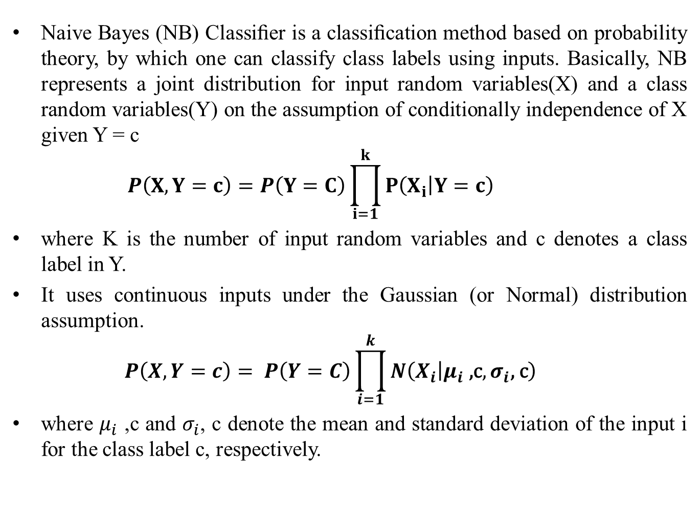
Gaussian Naive Bayes Classiﬁer
Naive Bayes (NB) Classiﬁer is a classiﬁcation method based on probability theory, by which one can classify class labels using inputs. Basically, NB represents a joint distribution for input random variables(X) and a class random variables(Y) on the assumption of conditionally independence of X given Y = c
$$Ρ\left(X,Y=c\right)=Ρ\left(Y=C\right)\prod_{i=1}^{k}{Ρ\left(X_{i} | Y=c\right)}$$
where K is the number of input random variables and c denotes a class label in Y.
It uses continuous inputs under the Gaussian (or Normal) distribution assumption.
$$Ρ\left(X,Y=c\right)= Ρ\left(Y=C\right)\prod_{i=1}^{k}{N\left(X_{i} | μ_{i}\text{ ,}\text{c},σ_{i}\text{, }\text{c}\right)}$$
where $μ_{i}$ ,c and $σ_{i}$, c denote the mean and standard deviation of the input i for the class label c, respectively.

Slide 11
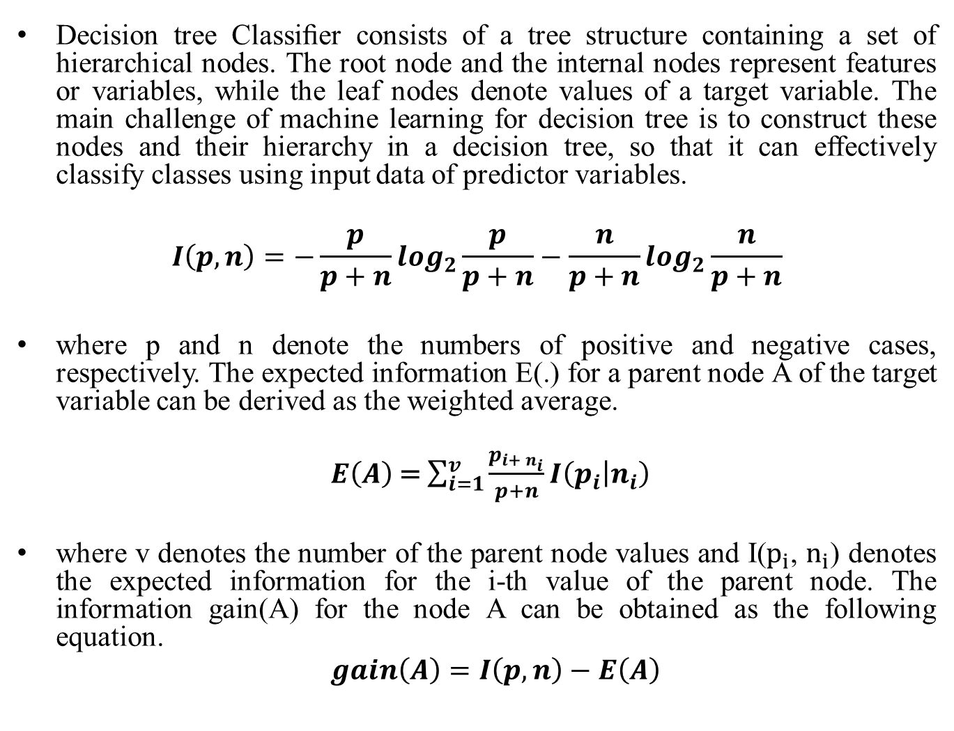
Decision Tree Classifier
Decision tree Classiﬁer consists of a tree structure containing a set of hierarchical nodes. The root node and the internal nodes represent features or variables, while the leaf nodes denote values of a target variable. The main challenge of machine learning for decision tree is to construct these nodes and their hierarchy in a decision tree, so that it can effectively classify classes using input data of predictor variables.
$$I\left(p,n\right)=−\frac{p}{p+n}\log_{2}\frac{p}{p+n}−\frac{n}{p+n}\log_{2}\frac{n}{p+n}$$
where p and n denote the numbers of positive and negative cases, respectively. The expected information E(.) for a parent node A of the target variable can be derived as the weighted average.
$E\left(A\right)$ = $\sum_{i=1}^{v}{\frac{p_{i+ n_{i}}}{p+n}}I\left(p_{i} | n_{i}\right)$
where v denotes the number of the parent node values and I($p_{i}$,$n_{i}$) denotes the expected information for the i-thvalue of the parent node. The information gain(A) for the node A can be obtained as the following equation.
$$gain\left(A\right)=I\left(p,n\right)−E\left(A\right)$$

Slide 12
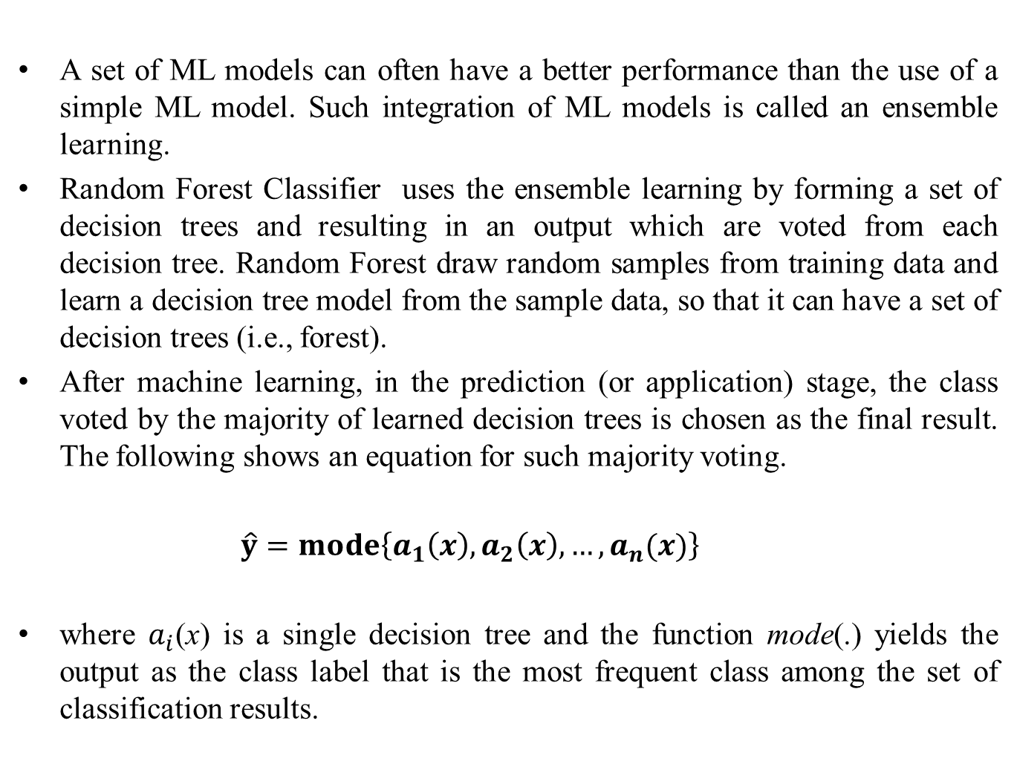
Random Forest Classifier
A set of ML models can often have a better performance than the use of a simple ML model. Such integration of ML models is called an ensemble learning.
Random Forest Classifier uses the ensemble learning by forming a set of decision trees and resulting in an output which are voted from each decision tree. Random Forest draw random samples from training data and learn a decision tree model from the sample data, so that it can have a set of decision trees (i.e., forest).
After machine learning, in the prediction (or application) stage, the class voted by the majority of learned decision trees is chosen as the final result. The following shows an equation for such majority voting.
$$\hat{y}=mode\left\{a_{1}\left(x\right),a_{2}\left(x\right),…,a_{n}(x)\right\}$$
where $a_{i}$(x) is a single decision tree and the function mode(.) yields the output as the class label that is the most frequent class among the set of classification results.

Slide 13
Gradient Boosting Classifier
Gradient Boosting Classiﬁer uses an ensemble model consisting of a set of simple models.
By adding such simple models, the result ensemble model can be sequentially improved and ﬁnally ﬁtted to data.
In other words, after applying a simple model, samples which are classiﬁed by it are reused to another simple model. And then this process is repeated until convergence (or achieving better predictive performance). Gradient Boosting Classiﬁer is a generalized method of boosting by using gradient of a loss function.

Slide 14
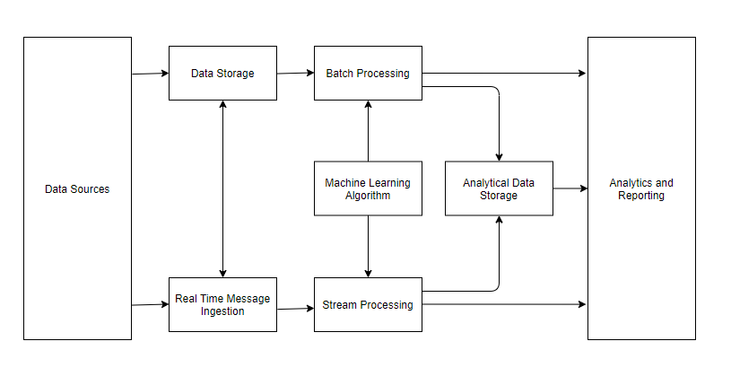
System Architecture

Slide 15
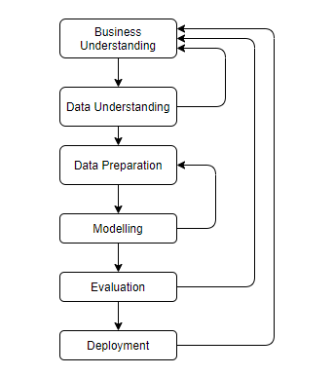
Schematic Representation of Modules

Slide 16
Business Understanding
In our project, our goal has two folds of objectives.
The first goal is to determine the most accurate machine learning model between Gaussian Naive Bayes, Decision Tree Classifier , Random Forest Classifier, Gradient Bosting Classifier for the given data.
The second is to construct a public web that will allow adolescents to know whether they will have the intention to smoke or not.
We utilize the data from NYTS for 2018 in order to construct ML models, and the models are analyzed to choose the most accurate one in predicting the intention for a non-smoker to smoke cigarettes.

Slide 17
Data Understanding
We found reliable data from the National Youth Tobacco Survey 2018 , which is a nation-wide survey for middle (grades 6-8) and high school (9-12) youth’s tobacco-related beliefs, attitudes, behaviors, and exposure to pro and anti-tobacco inﬂuences.
NYTS implements a three-stage cluster sampling design in order to get a nationally representative data for students from grades 6-12 in all over the world.
There are a total of 88 questions in the survey and we examined all of the questions and picked the questions that were necessary making the model to predict the whether a person has the intention to smoke or not.
Question Number | Question | Answer
Q1 | How old are you? | 9, 10, ..., 19 years old
Q2 | What is your sex? | Male/Female
Q3 | What grade are you in? | 6, 7, ..., 12, ungraded or other grade
… | ... | …
Q88 | Because of a physical…making decisions? | No/Yes

Slide 18
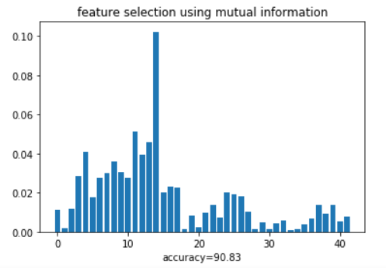
Data Preparation
Data Preparation is the process of converting the initial, or raw, data set into the final data set. This step could alter the data to become more applicable to achieve the goal.
We use Mutual Information Classification Algorithm to find Correlation between the predictor variables to target variables and accuracy of about 90.83 is obtained.

Slide 19
Modeling
We used four ML algorithms to generate each ML model using a training data and evaluated the accuracy for each one of the models. The models include (1) Decision Tree Classiﬁer, (2) Gaussian NB Classiﬁer,(3) Gradient Boosting Classiﬁer, and (4) Random Forest Classiﬁer.
Out of the whole data set, we assigned the training data set, which is 80 percent of the original data, and the test data set, which is 20 percent of the original data.
The training data set is used to learn the prediction model while the test data set is used to test the learned model by evaluating the accuracy for each model.
After examining the predicted accuracy, we can evaluate the model that showed the highest accuracy.

Slide 20
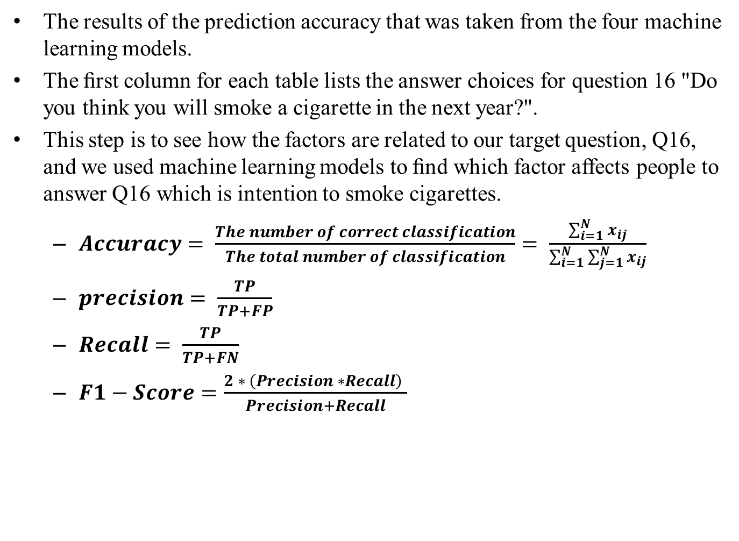
Evaluation
The results of the prediction accuracy that was taken from the four machine learning models.
The ﬁrst column for each table lists the answer choices for question 16 "Do you think you will smoke a cigarette in the next year?".
This step is to see how the factors are related to our target question, Q16, and we used machine learning models to ﬁnd which factor affects people to answer Q16 which is intention to smoke cigarettes.
$Accuracy= \frac{The number of correct classification}{The total number of classification}= \frac{\sum_{i=1}^{N}{x_{ij}}}{\sum_{i=1}^{N}{\sum_{j=1}^{N}{x_{ij}}}}$
$precision= \frac{TP}{TP+FP}$
$Recall= \frac{TP}{TP+FN}$
$F1−Score=\frac{2 ∗ \left(Precision ∗Recall\right) }{Precision+Recall}$
 | Gaussian NB | Decision Tree | Random Forest | Gradient Boosting
Training Score | 0.857 | 0.893 | 0.927 | 0.930
Test Score | 0.845 | 0.888 | 0.926 | 0.928

Slide 21
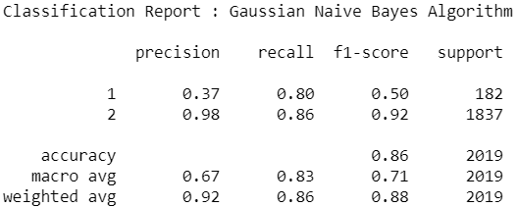
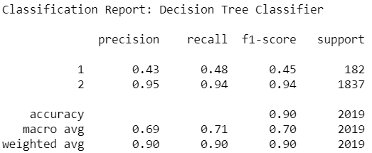
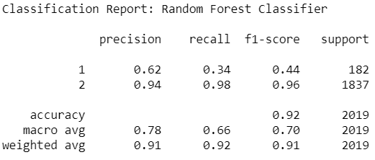
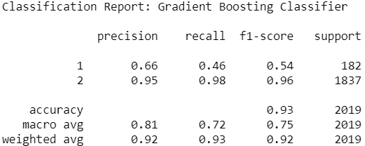
Classification report

Slide 22
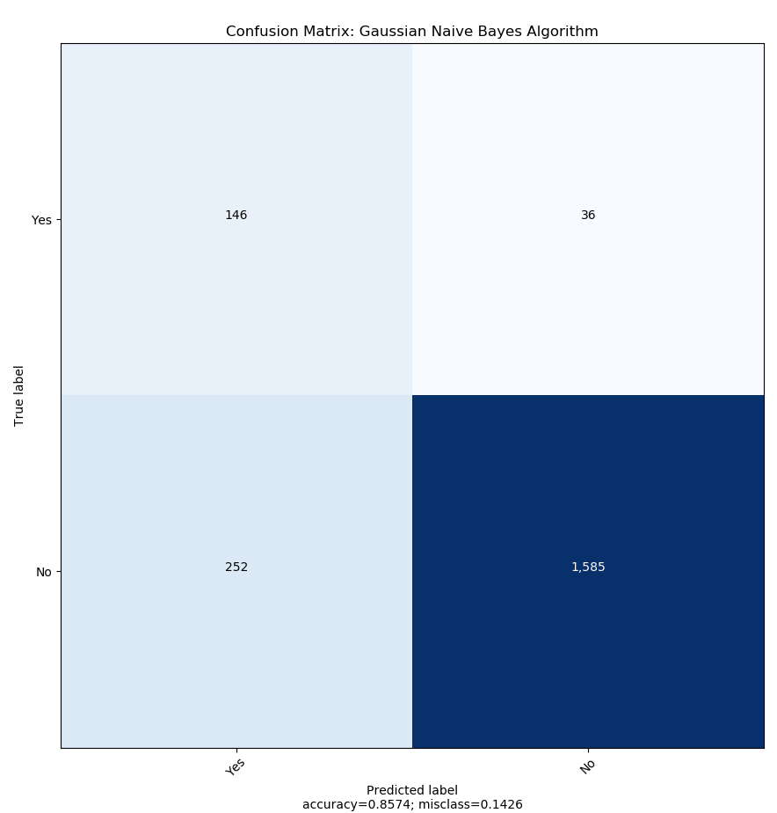
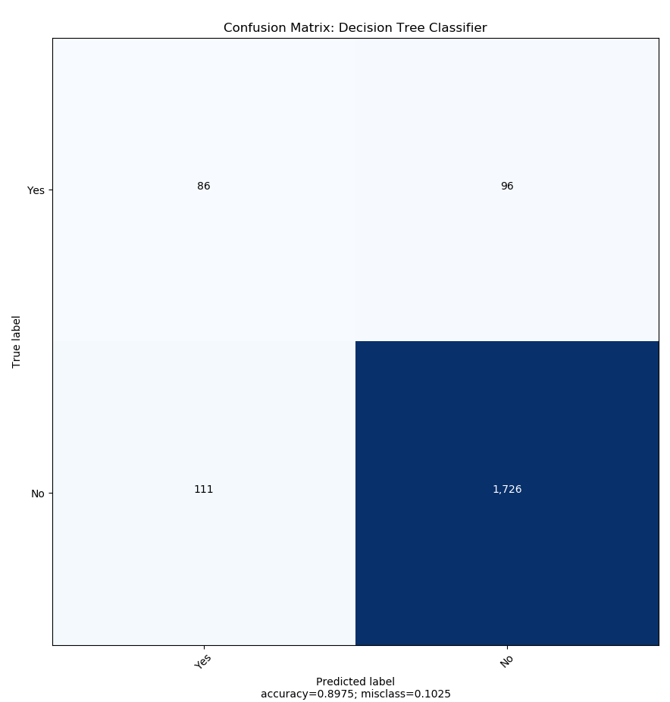
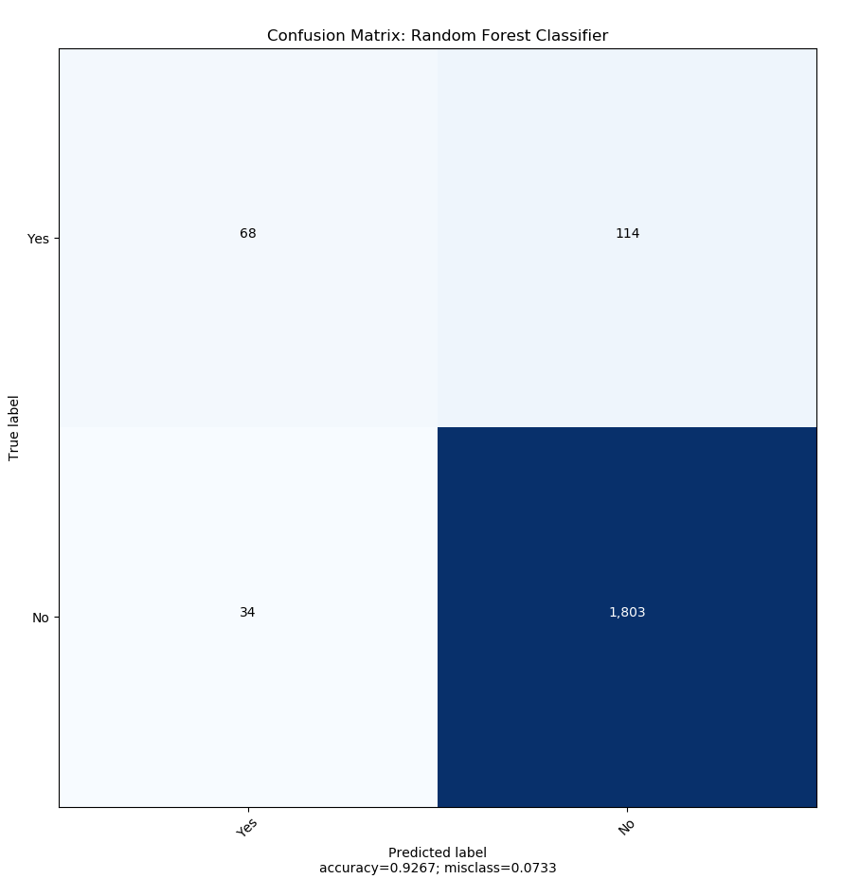
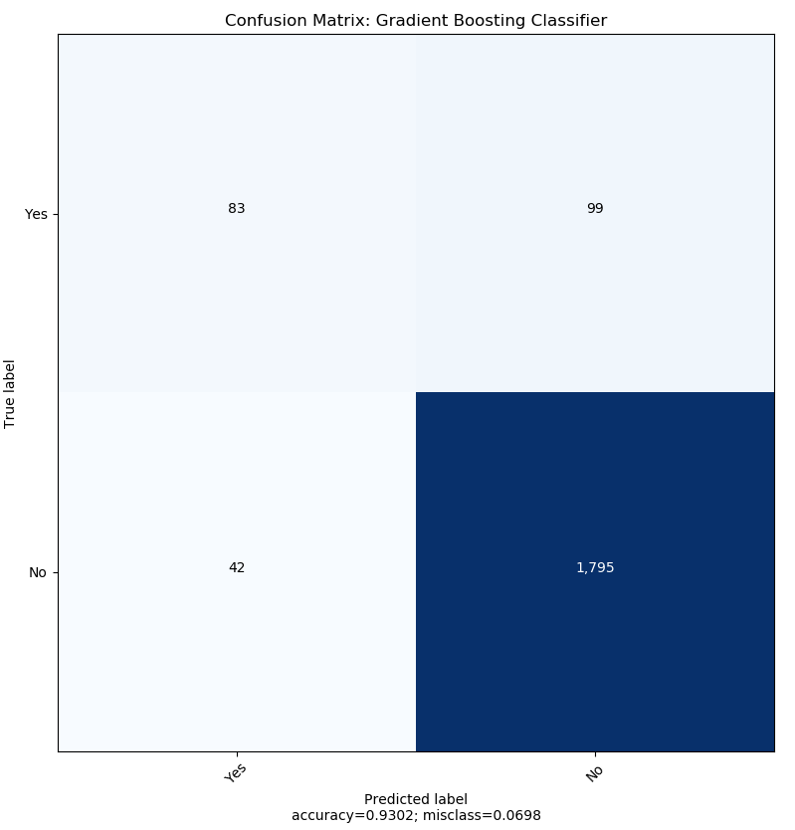
Confusion Matrix

Slide 23
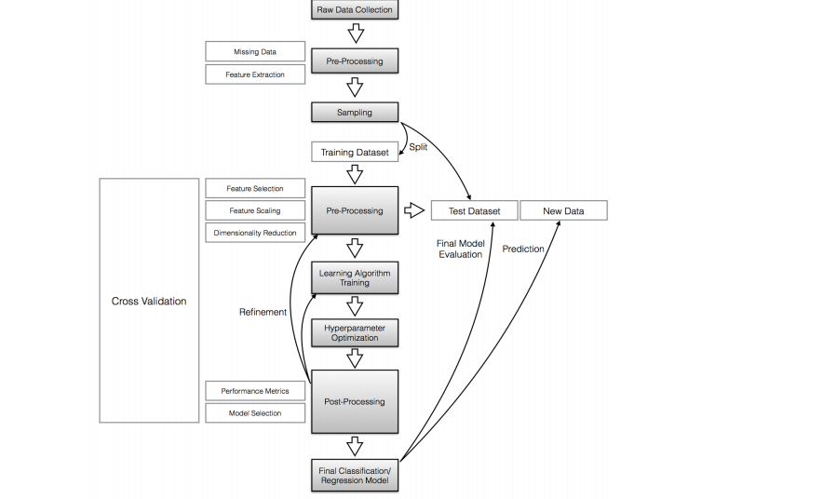
Algorithm Flowchart

Slide 24
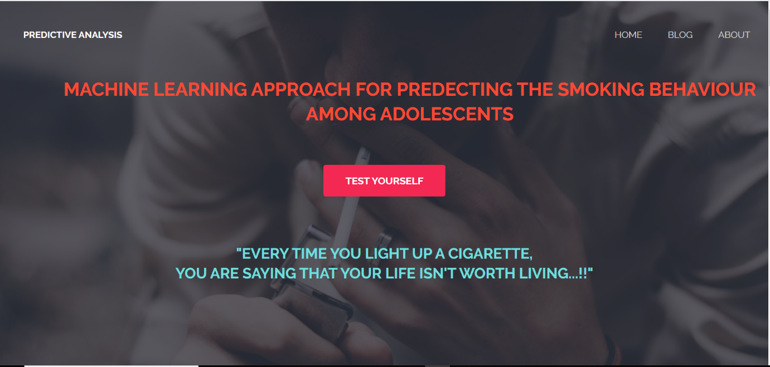
Screen Shots

Slide 25


Slide 26
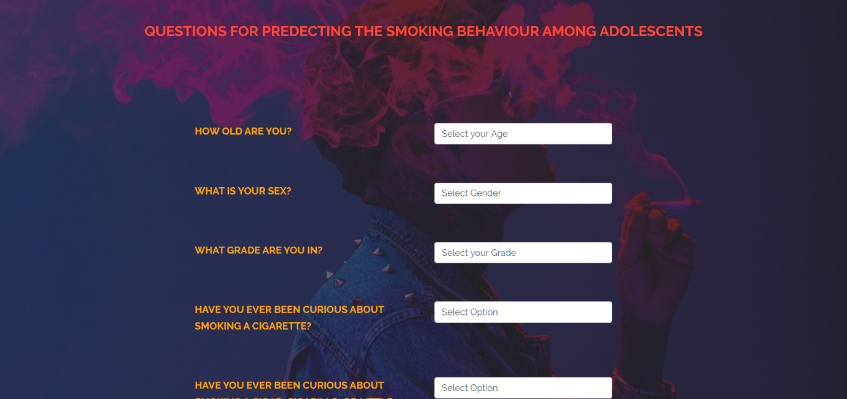

Slide 27
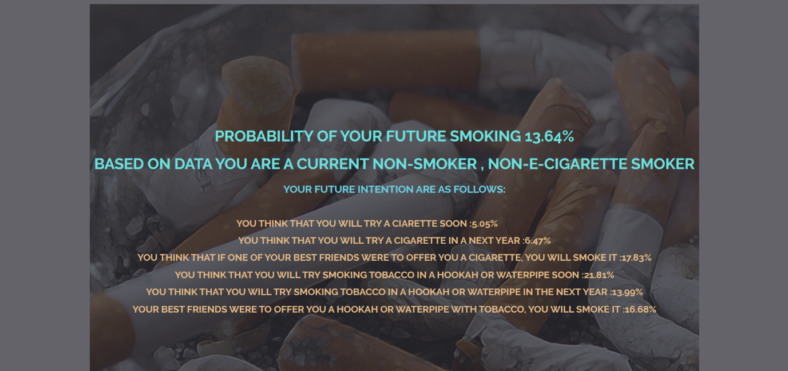

Slide 28
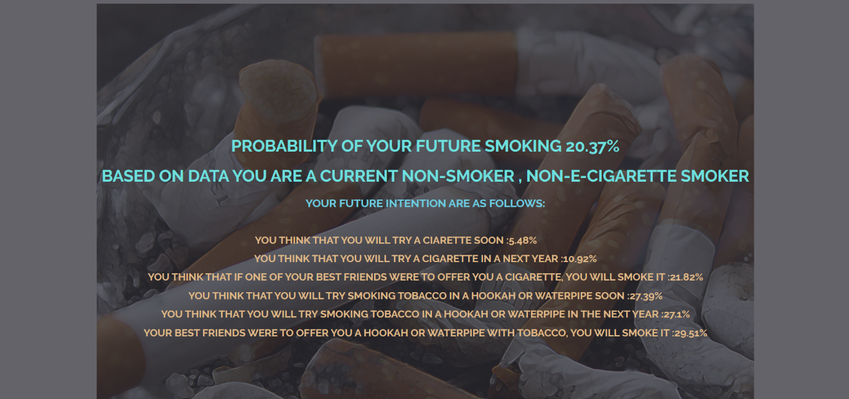

Slide 29
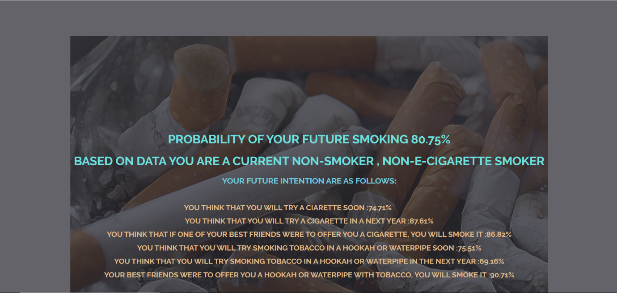

Slide 30
References
National Youth Tobacco Survey(NYTS) https://www.cdc.gov/tobacco/data_statistics/surveys/nyts/index.htm Accessed: 2019-04-20.
Murphy, K.P. Machine learning: a probabilistic perspective; MIT press, 2012.
Quinlan, J.R. Induction of decision trees. Machine learning 1986, 1, 81–106.
Freund, Y. Schapire others. Experiments with a new boosting algorithm icml Citeseer, 1996, Vol. 96, pp. 148–156.
Yupu Zhang, Junnan Huang, Prediction of daily smoking behaviour based on decision tree machine learning, Feb 2019
J.H. Friedman, “Greedy Function approximation: a gradient boosting machine”,Annals of statistics, 2001, pp.1189-1232

